Slide 1
Decision Tree and Extreme Learning Machine based Single Image Super-Resolution
Notes:
Single image super-resolution is known to be an ill-posed problem, which has been studied for decades. Current state-of-the-art methods are typically time-consuming with high computational complexity. It is challenging to apply these methods to real-time applications or on devices with low computational capability. Our method ,called Decision Tree and Extreme Learning Machine based Single image super-resolution , is very a fast and effective method for Single Image Super-Resolution. Now I will introduce our method briefly.

Slide 2
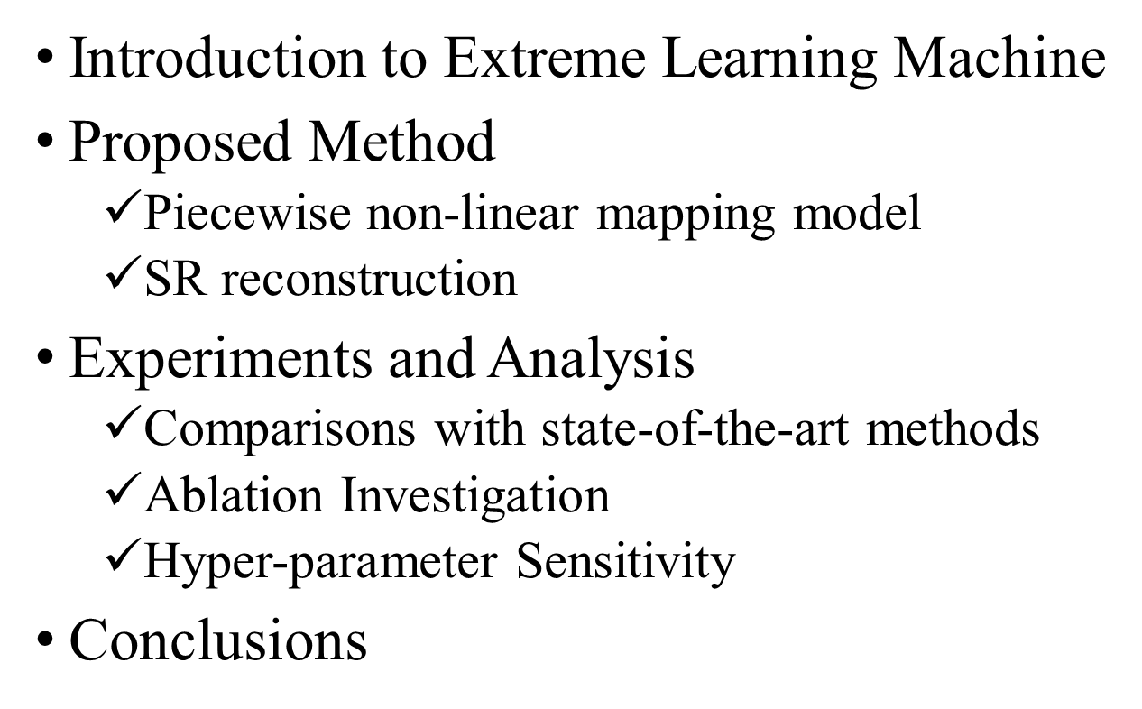
Content
Notes:
There are four important parts mainly to be introduced: Introduction to ELMs, Proposed Method, Experiments and Analysis, and Conclusions

Slide 3
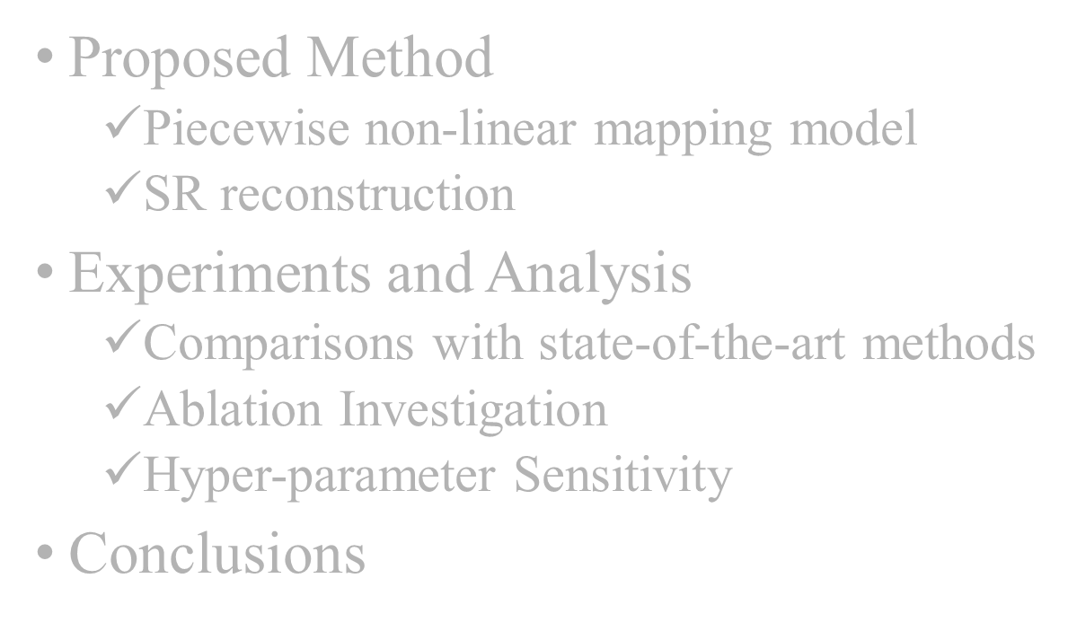
Introduction to Extreme Learning Machine

Slide 4
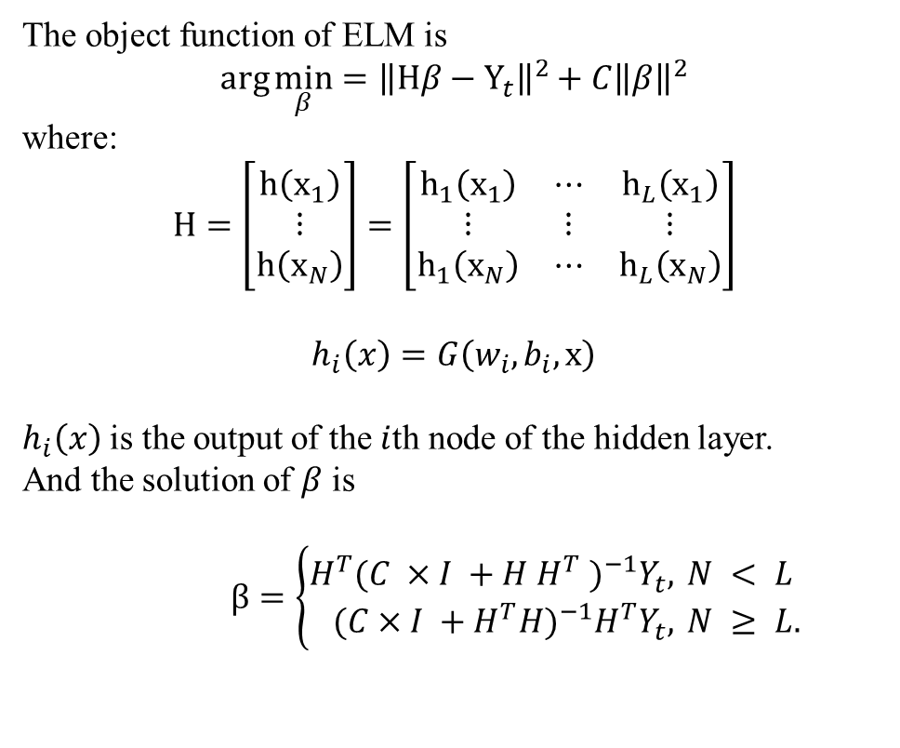
ELM is a fast learning algorithm for training a single-hidden-layer feedforward neural network (SLFN).
The object function of ELM is
$$\arg{\min_{β}{={\left\|Hβ−Y_{t}\right\|}^{2}+C{\left\|β\right\|}^{2}}}$$
where:
$$H=\left[\begin{matrix}h\left(x_{1}\right) \\ ⋮ \\ h\left(x_{N}\right)\end{matrix}\right]=\left[\begin{matrix}h_{1}\left(x_{1}\right) & ⋯ & h_{L}\left(x_{1}\right) \\ ⋮ & ⋮ & ⋮ \\ h_{1}\left(x_{N}\right) & ⋯ & h_{L}\left(x_{N}\right)\end{matrix}\right]$$
$$h_{i}\left(x\right)=G\left(w_{i},b_{i},x\right)$$
$h_{i}\left(x\right)$ is the output of the $i$th node of the hidden layer.
And the solution of $β$ is
$β=\left\{\begin{aligned}H^{T}(C ×I +H H^{T} )^{−1}Y_{t}, & N < L \\ (C×I +H^{T}H)^{−1}H^{T}Y_{t}, & N ≥ L.\end{aligned}\right.$
Notes:
Structure of an ELM. n is the number of nodes in the input layer. The parameters between input layer and hidden layer are generated randomly, thus H is easily computed. Based on H, the ELM degenerates to a simple linear regression problem, where the parameter $β$between the hidden layer and the output layer can be easily and quickly solved.

Slide 5
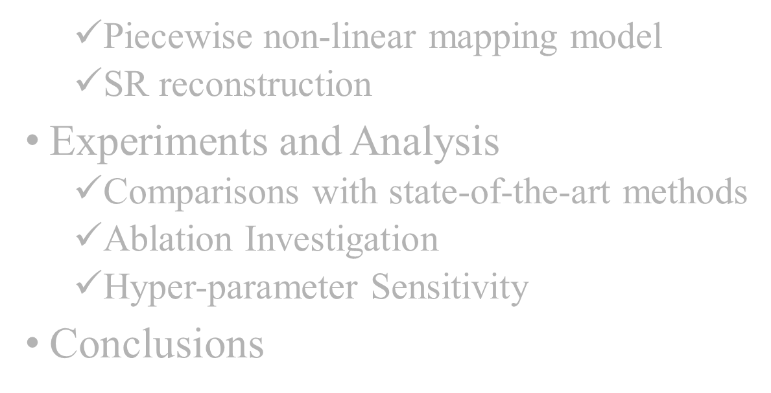
Introduction to Extreme Learning Machine
Proposed Method
Notes:
Proposed Method.

Slide 6
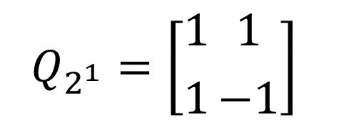
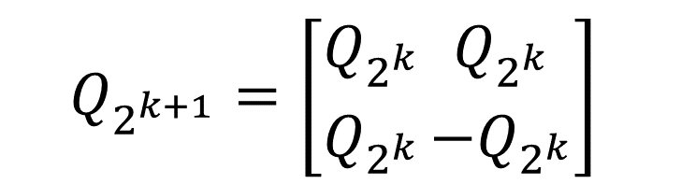
Main Idea
Divide the patches into some subspaces
Divide rules Hadamard Matrix
Each column of the Hadamard matrix can be treated as a convolutional filter.
The Hadamard transform only requires addition and subtraction operators.
$$Q_{2^{1}}=\left[{1 \atop 1}\left.{1 \atop −1}\right]\right.$$
$$Q_{2^{k+1}}=\left[{Q_{2^{k}} \atop Q_{2^{k}}}\left.{Q_{2^{k}} \atop −Q_{2^{k}}}\right]\right.$$
Notes:
The core idea of our proposed method is to divide the LR feature space into several subspaces, where a separate mapping from LR to HR patches is learned for each subspace. We use Hadamard Matrix to extract the features of patches and divide each node in the decision tree into three ones. Hadamard Matrix can be generated iteratively.

Slide 7
Main Idea
Divide the patches into some subspaces
Divide rules Hadamard Matrix
Decision Tree
Notes:
Starting from the root node that contains all the patches, the algorithm divides the patches in each node into three child nodes according to the extracted Hadamard patterns and two experimentally determined thresholds in the node.

Slide 8
Main Idea
Divide the patches into some subspaces
Divide rules Hadamard Matrix
Decision Tree
Learning mapping model in every subspaces
Extreme Learning Machine
At each leaf node, an ELM is adopted to learn a mapping from LR to HR patches.

Slide 9

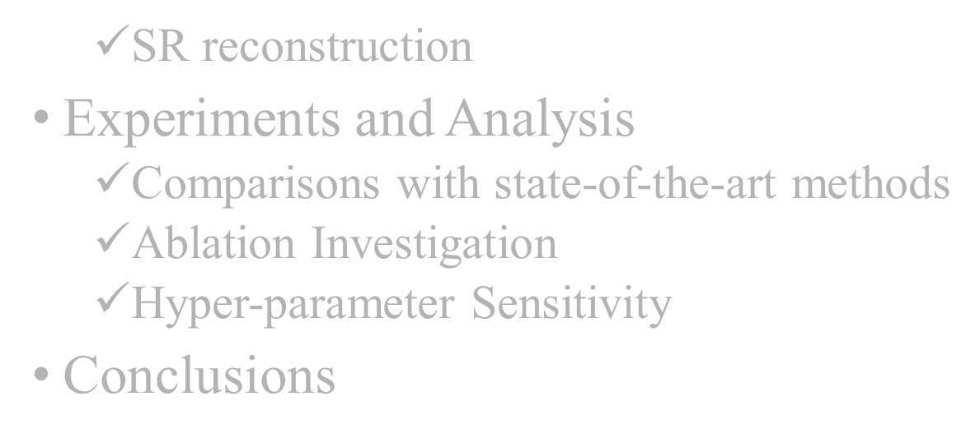
Introduction to Extreme Learning Machine
Proposed Method

Slide 10
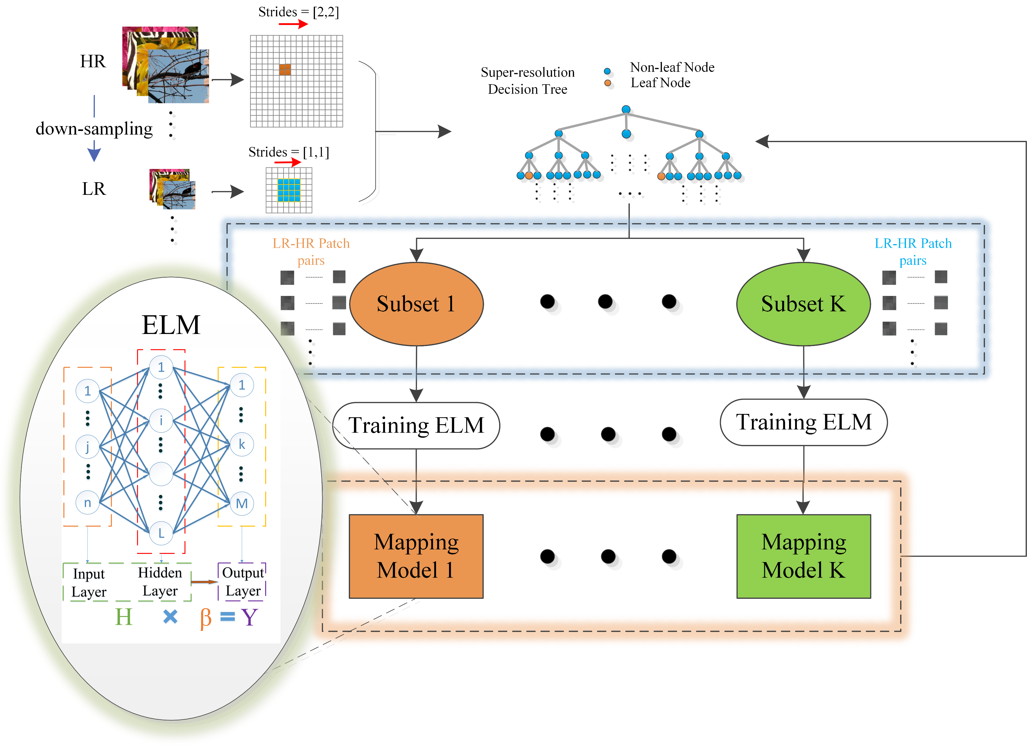
Notes:
Patches are clustered by a ternary decision tree. Patches divided into same subspace are similar enough for building an accurate and efficient mapping from low-resolution patches to corresponding high-resolution patches. An ELM is used as the mapping function. All the ELMs and the decision tree form the piecewise nonlinear Super-resolution function.

Slide 11
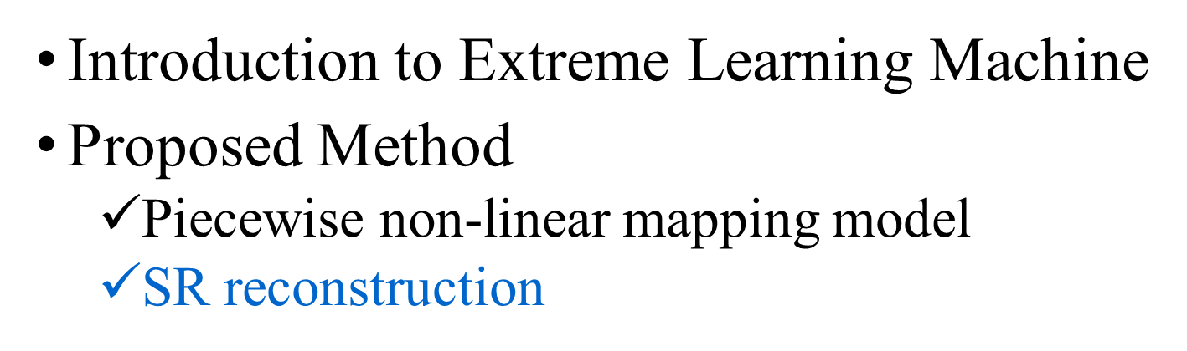
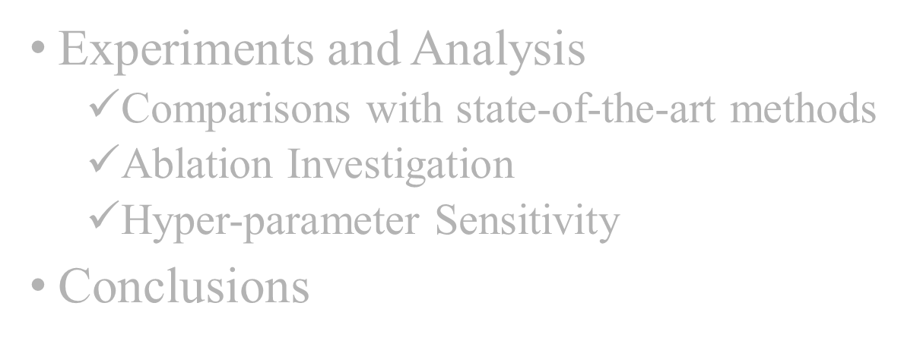
Notes:
But, how to use the model above to get a high-resolution image at testing time?

Slide 12
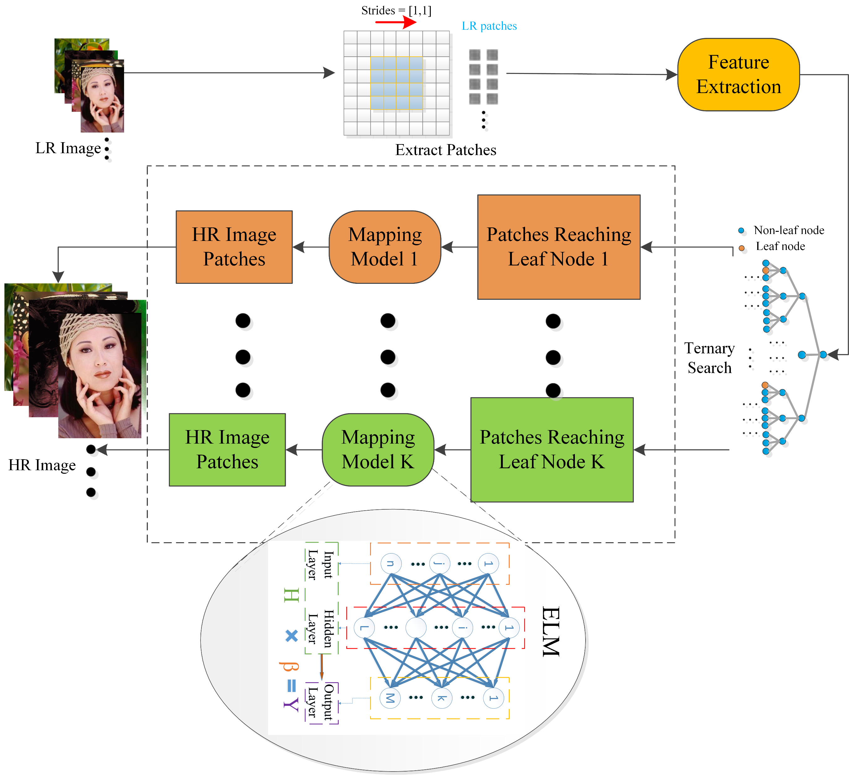
Notes:
For reconstruction, DELM-SR first extracts LR image patches from input and Hadamard transform is performed on patches to compute their Hadamard patterns. The computed Hadamard patterns are then used to traverse the decision tree to locate corresponding mapping models for efficiency. Finally, these LR image patches are mapped to the HR subspaces in their corresponding leaf nodes to get the predicted HR patches.

Slide 13
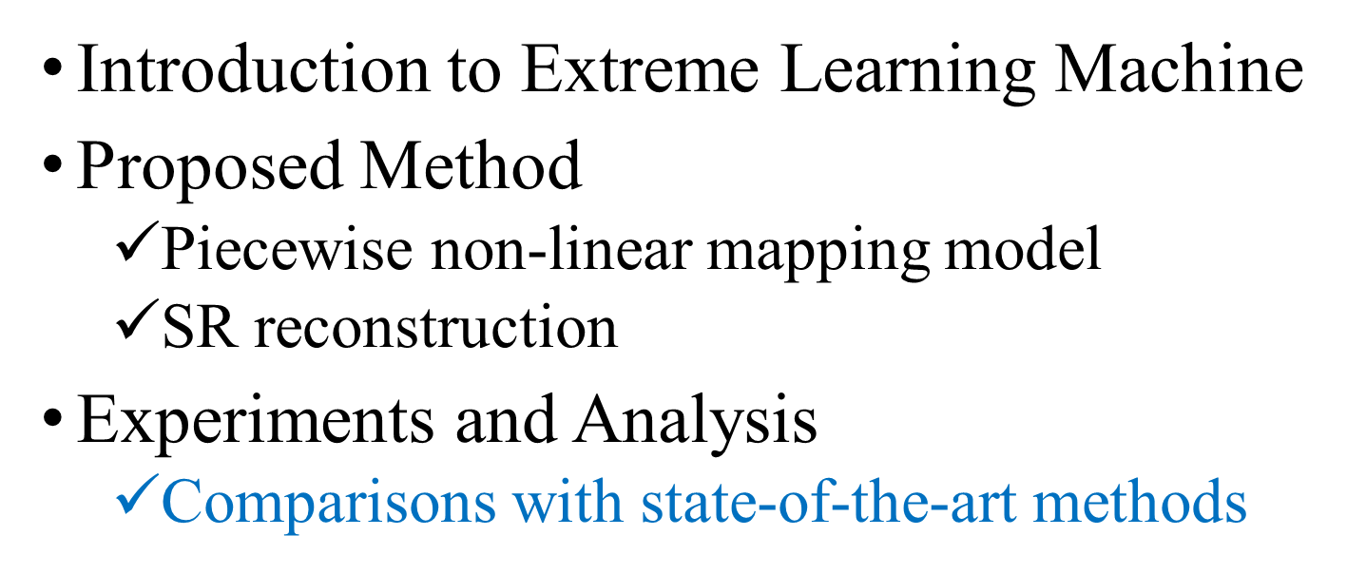
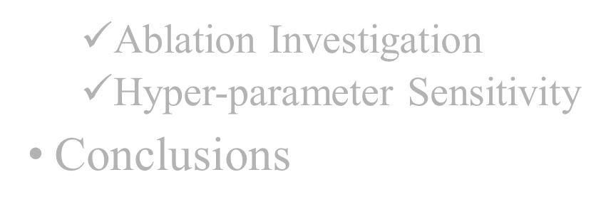
Notes:
Extensive experiments on benchmark datasets show that the utility of the proposed method for image super-resolution in speed, accuracy and robustness.

Slide 14
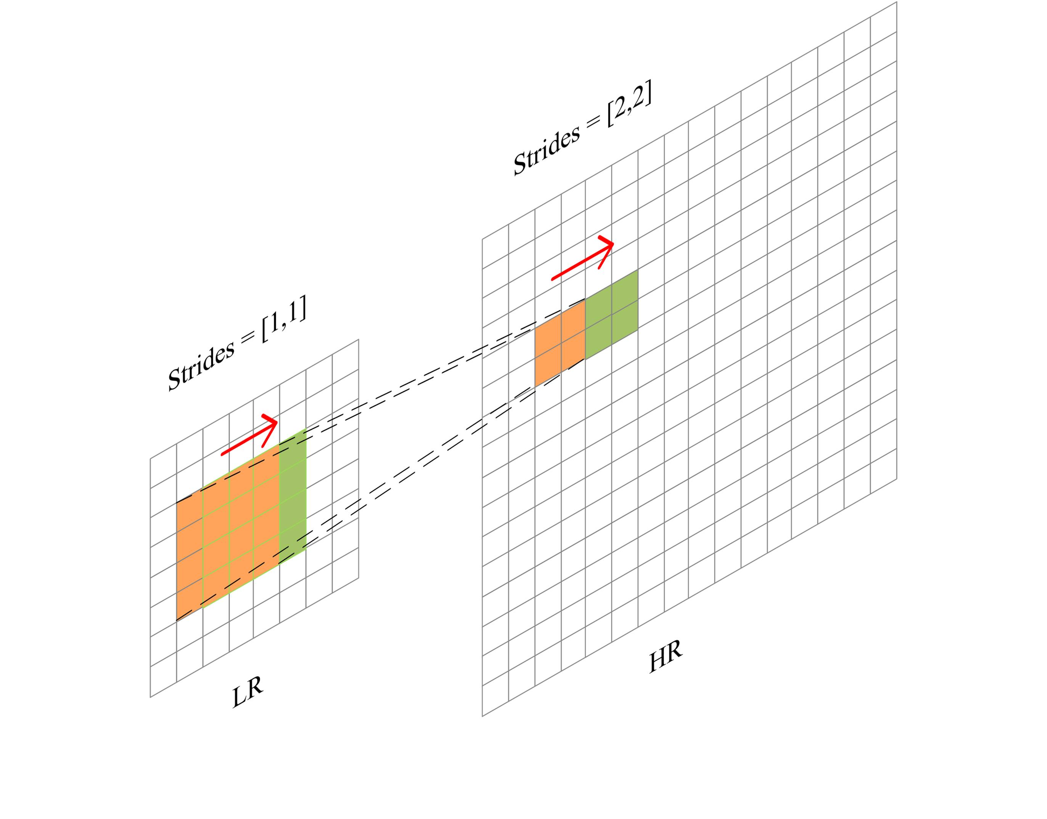
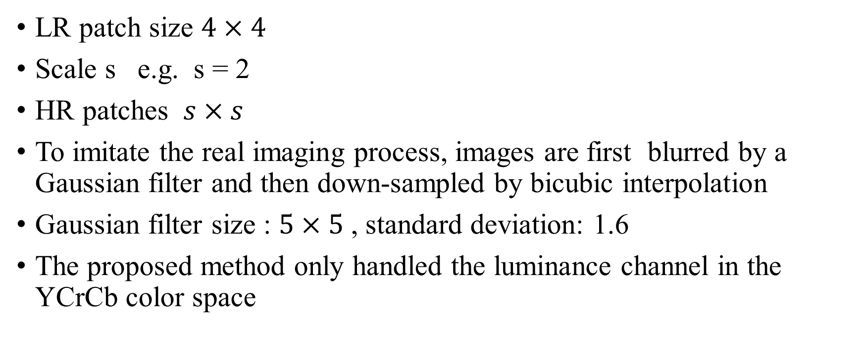
Experimental Setting
LR patch size $4×4$
Scale s e.g. s = 2
HR patches $s×s$
To imitate the real imaging process, images are first blurred by a Gaussian filter and then down-sampled by bicubic interpolation
Gaussian filter size : $5×5$ , standard deviation: 1.6
The proposed method only handled the luminance channel in the YCrCb color space

Slide 15
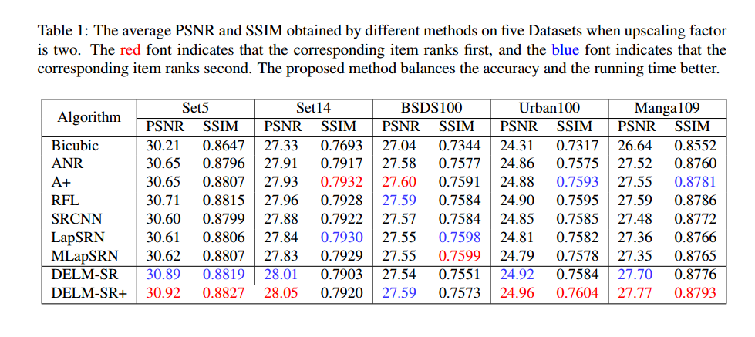
Notes:
It is shown that our DELM-SR and DELM-SR+ achieve higher PSNR on most datasets in comparison with other SR algorithms.

Slide 16
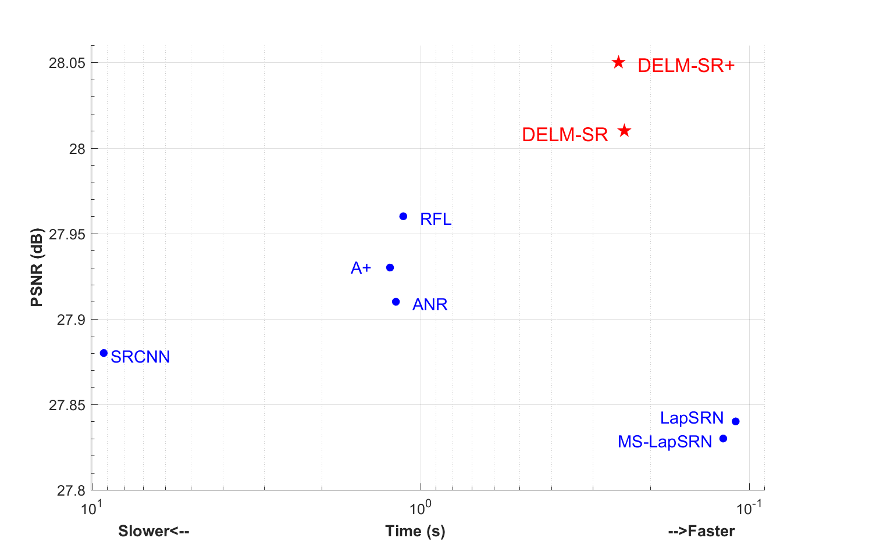
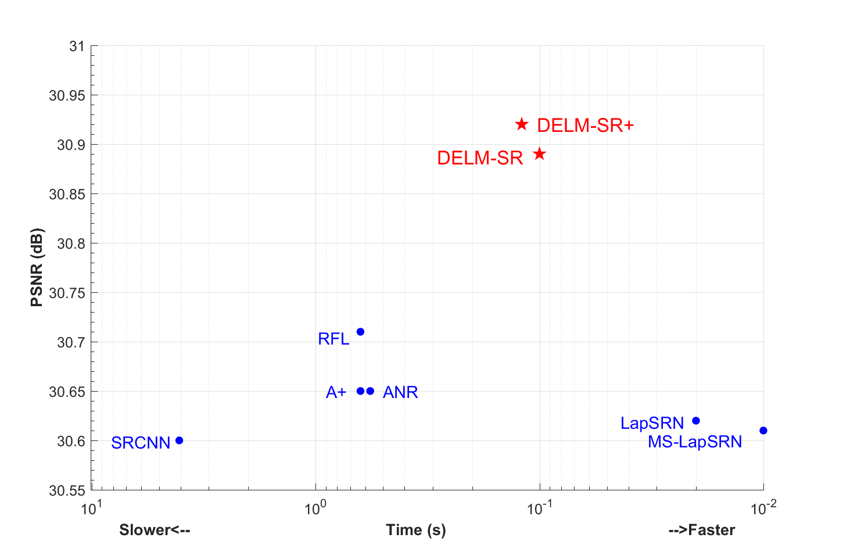
PSNR vs. Speed for the tested methods on Set5 (a) and Set14 (b). The proposed DELM-SR and DELM-SR+ methods (highlighted in red) achieve both fast speed and high quality.
Notes:
We visualize the trade-off between upscaling quality and inference time of different methods on Set5 and Set14. It is obvious that our DELM-SR and DELM-SR+ methods can generate high quality images with less time compared with most state-of-the-art methods.

Slide 17
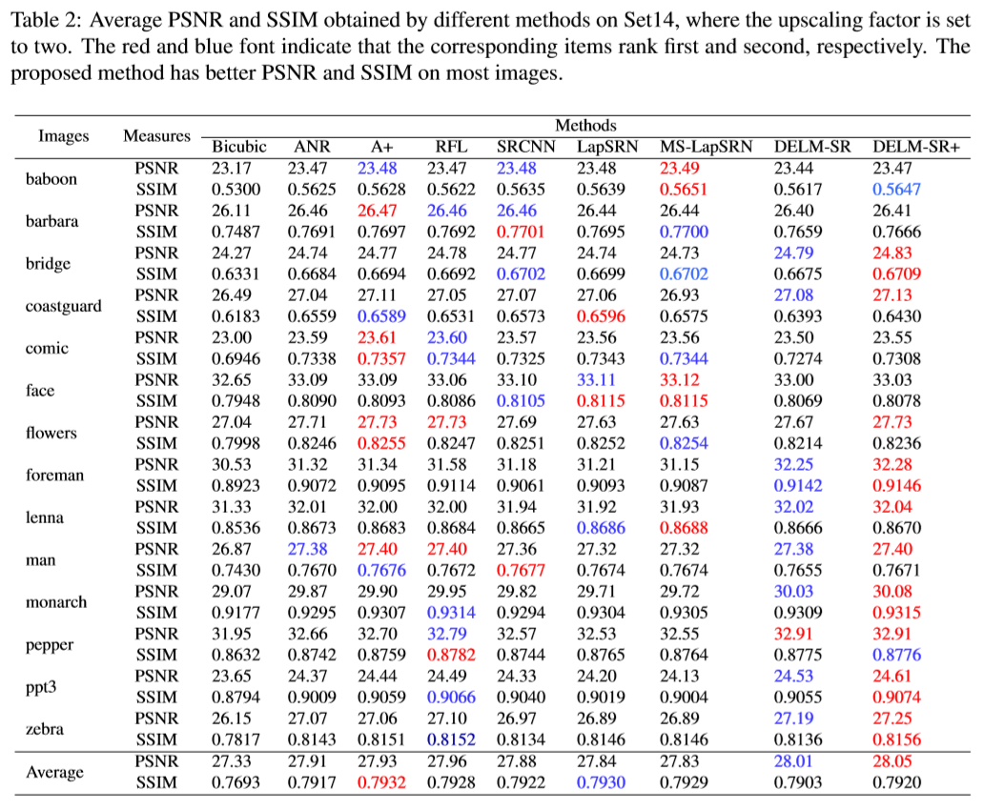
Notes:
Table 1 shows a detailed comparison on Set14. As is shown, our method produces higher PSNR and SSIM on most images in comparison with the state-of-the-art methods.

Slide 18
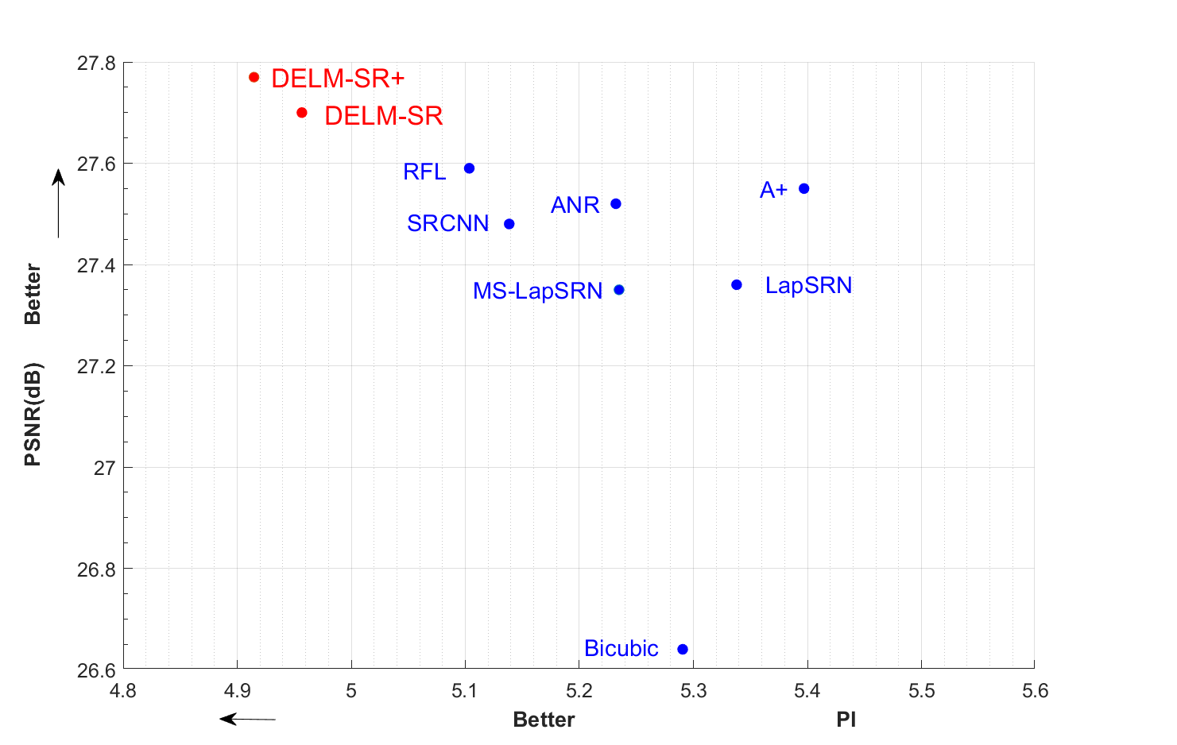
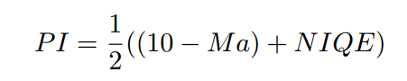
PI index
The perception index is highly-correlated with human opinion scores
The trade-off between Perceptual index and PSNR on Manga109. Lower PI means better perceptual quality. It can be found that our DELM-SR and DELM-SR+ have better performance on both PI and PSNR. Our methods can produce images with less distortion (higher PSNR) and better perceptual quality (lower PI) comparing with state-of-the-art methods
Notes:
Blau et al. proved mathematically that the rising of PSNR and SSIM values are not always accompanied with the improvements of visual quality. And they used the perception index (PI), which combined the no-reference image quality measures NIQE and Ma et al. , to get perceptual quality.
We can find that our methods have better perceptual quality with less distortion.

Slide 19
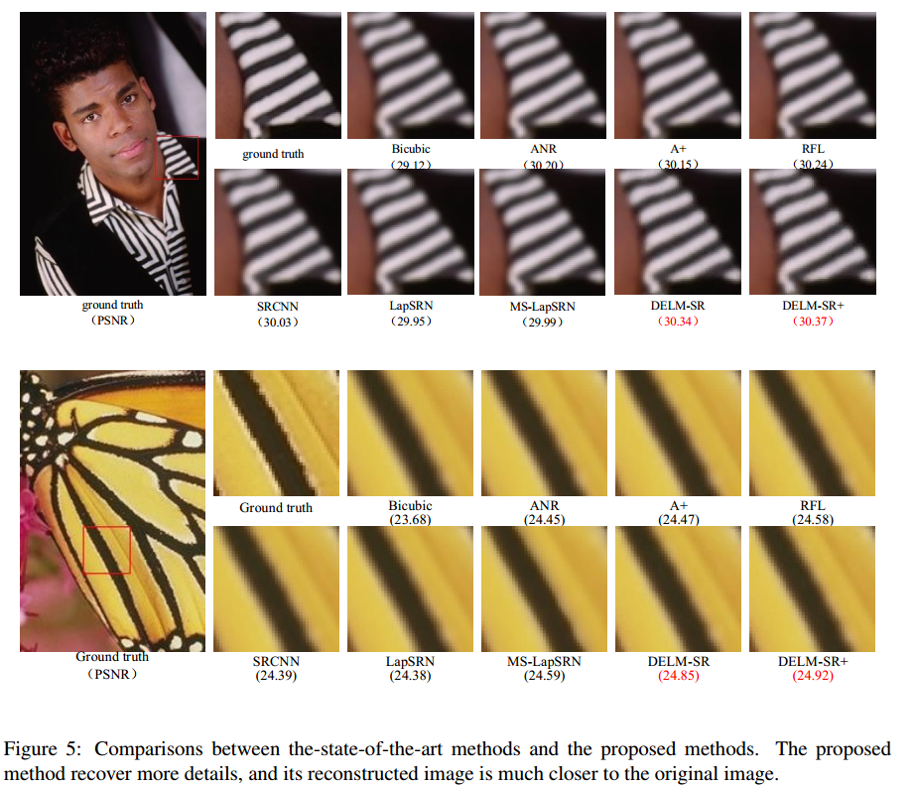
Notes:
We qualitatively compare our method with the-state-of-the-art methods. We can clear find that our method has more details and save more high frequency information than others.

Slide 20
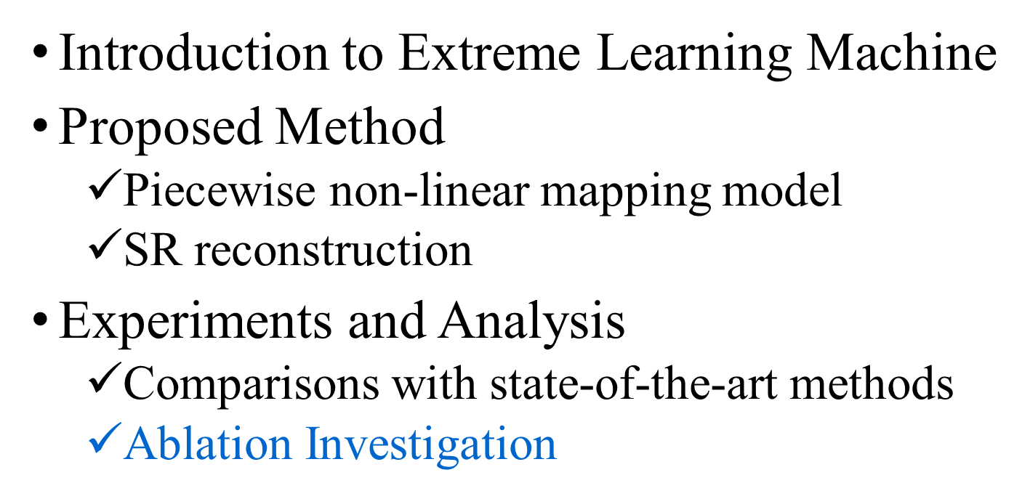
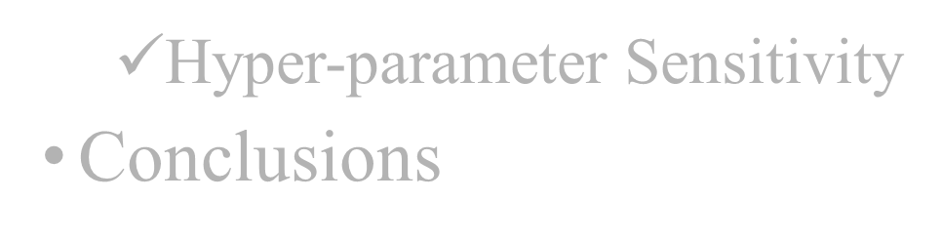

Slide 21
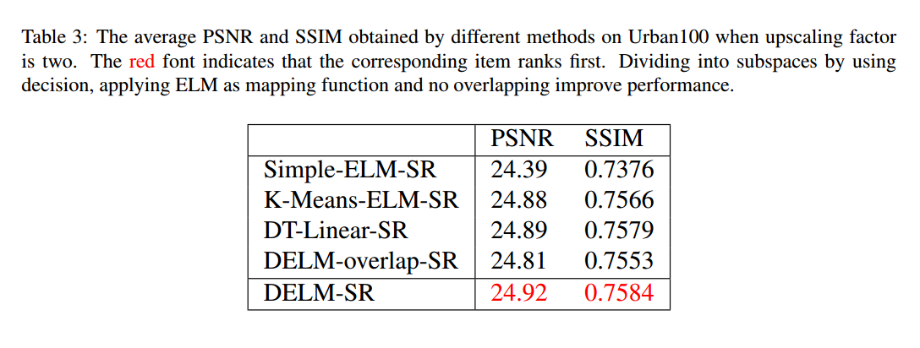
Ablation Study
Notes:
Simple-ELM-SR. ELM is used to learn a mapping function from LR space to HR space directly without dividing patches into different subspaces.
K-Means-ELM-SR The LR space is first divided into several subspaces by K-Means, then ELM is applied to learn mapping models for each subspace. The number of centroids is set to 1000, which is approximate to the number of leaf nodes in our method.
DT-linear-SR. Different from K-Means-ELM-SR, the LR space is divided by a Hadamard decision tree. Moreover, linear regression instead of ELM is adopted as mapping models.
DELM-overlap-SR. The LR patches and HR patches are both overlapped and we set the size of LR patches to $4×4$ and HR patches to $8×8$ . At the same time, strides in LR and HR patches are both [1,1].
We can find that dividing patches into subspaces is more accurate and efficient by using K-Means (+0.49dB) and decision tree (+0.53dB) than simple-ELM-SR. Nonlinear mappings have better performance than Linear mappings. Overlapping in HR images is harmful for reconstructing image with high quality.

Slide 22
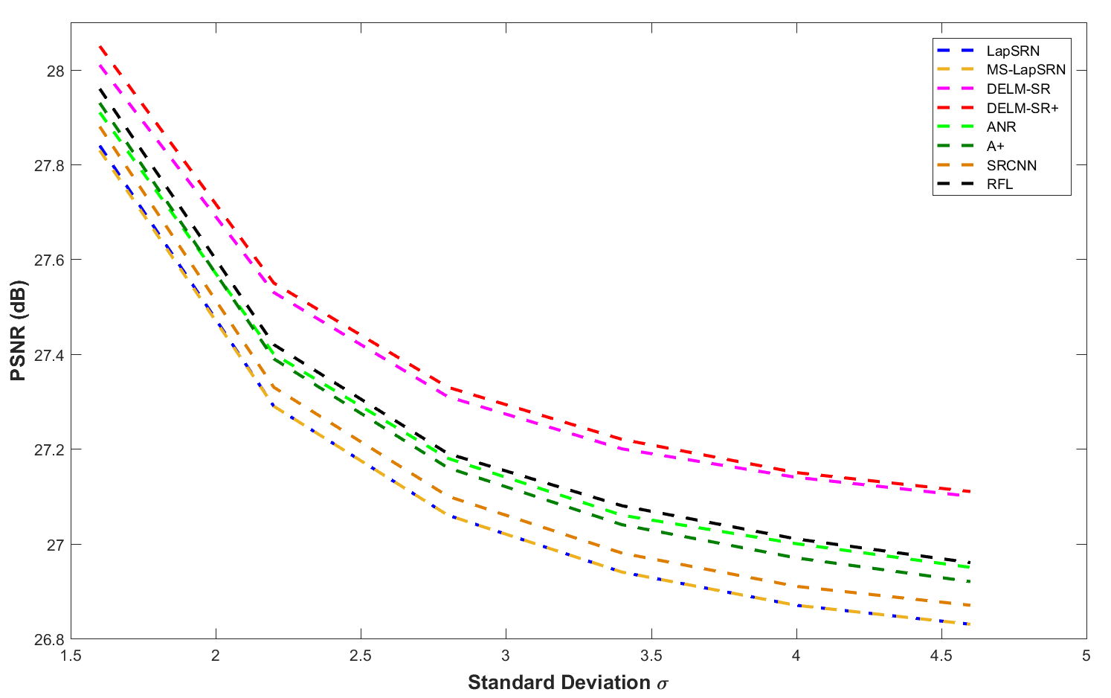
More Robust
The performances of our method versus the state-of-the-art methods on Set14 with increasing the degree of image blurring with the upscaling factor setting to two.
Notes:
We also use our method and the state-of-the-art methods to produce images in different conditions. It is shown that our method is more robust and has better performance under different conditions compared with the state-of-the-art methods.

Slide 23
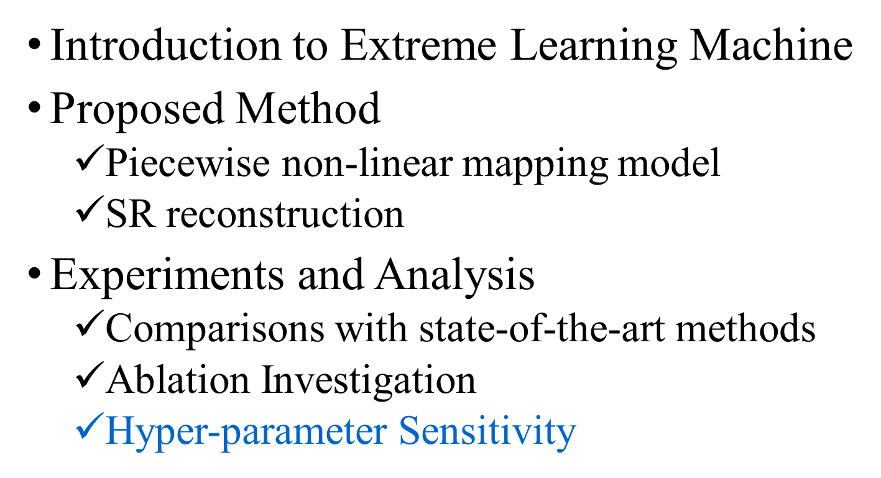


Slide 24
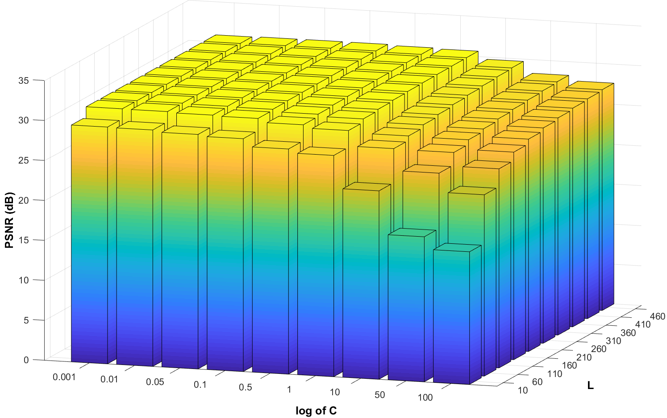
Hidden nodes and regularization parameter
Influence of the number of hidden nodes and the regularization parameter on PSNR.
Notes:
The number of hidden nodes L and the regularization parameter C are important for good reconstruction performance. We verify the impact of performance on the two factors with the same decision tree. We set L $∈$ {10,60,110,...,460} and C $∈${0.001, 0.01, 0.05, 0.1, 0.5, 1, 10, 50, 100} in experiments.
We can observe that the proposed method is more sensitive to the regularization parameter. A relative small regularization parameter with an appropriate number of hidden nodes typically can improve the PSNR.

Slide 25
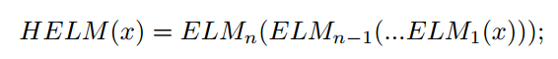
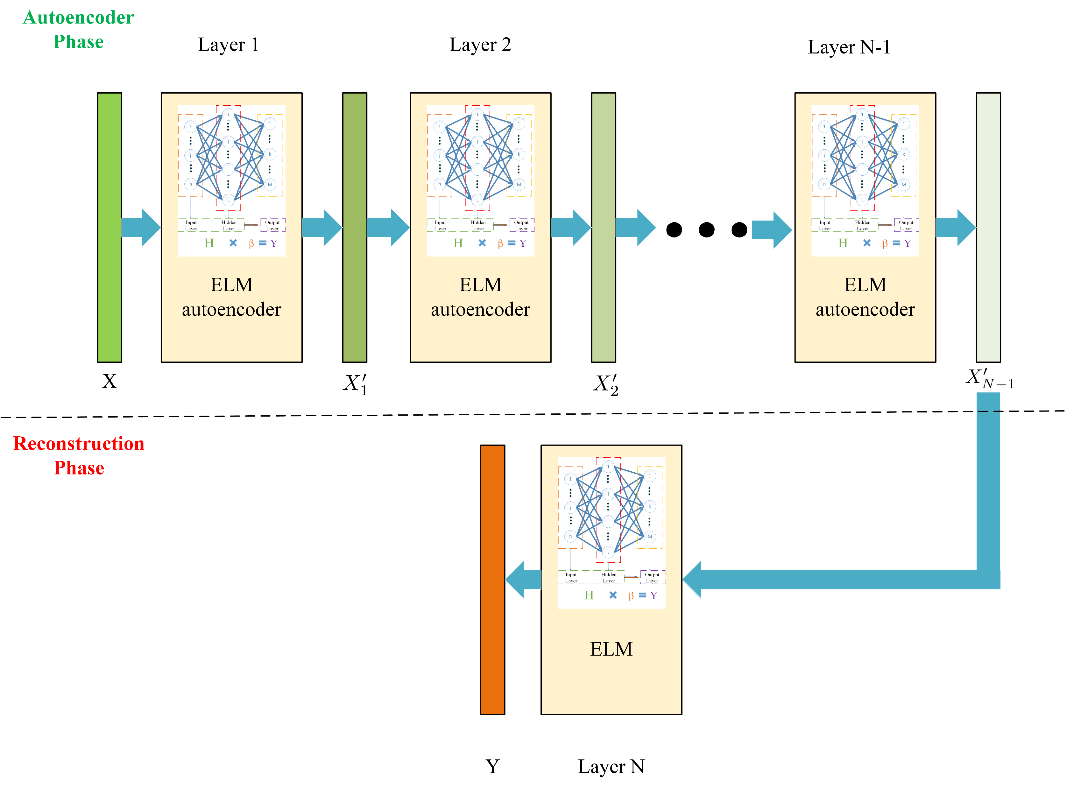
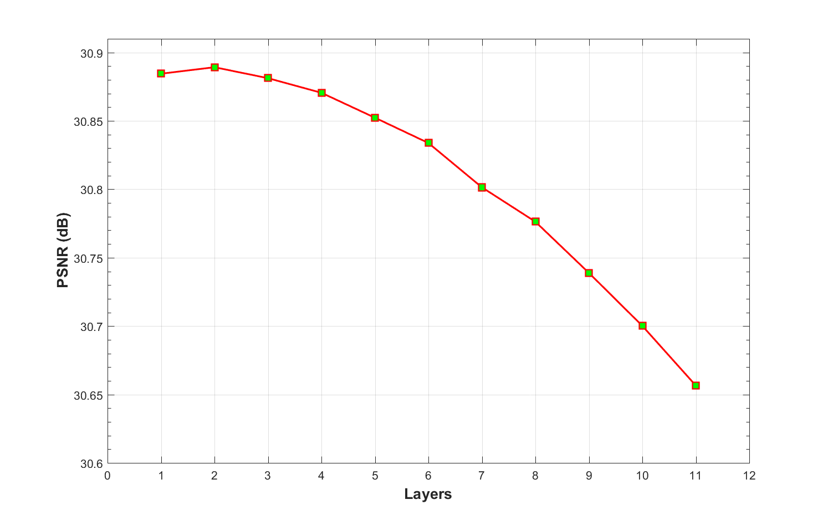
Layers of ELM
The architecture of hierarchical ELM in our methods
Changes of PSNR with an increasing number of layers.
Notes:
An H-ELM can be represented with two components: an ELM-based sparse autoencoder (1...(n-1)th layer) and a classification ELM (the last layer).
We can find that when the number of layers increases to 2, little improvement of average PSNR is found; whereas the average PSNR drops significantly when the number of layers increases from 2 to 11. We suppose that this is due to the architecture of autoencoder, which makes loss of detailed information be accumulated with increasing number of layers.

Slide 26
Conclusions
We propose a Decision Tree and ELM based Single Image Super-resolution (DELM-SR) method, where the decision tree is used to build fast and accurate partitions of LR-HR patches, and the ELMs for quick nonlinear inferences.
Extensive experiments show fast and robust performance of our method compared with the state-of-the-art methods when the input images are blurred. Our proposed DELM-SR method is superior in computational complexity, PSNR, SSIM, and the perceptual quality of HR images.

